Slide 1

PROJECT REVIEW
Legal Document RAG System with Hallucination Reduction
Ishika Agrawal - 22BDS0245
Brian Thomas Mathew - 22BBS0108
Shubham Kumar - 22BCB0108

Slide 2


Why This System Exists
The Problem
Millions of Indians sign rent agreements, employment contracts, and loan documents without understanding the legal clauses inside them. Legal language is dense, technical, and inaccessible to non-lawyers.
Existing AI tools often hallucinate — inventing fake section numbers or misquoting Acts — which is dangerous in a legal context.

Slide 3
Research Objectives
1
2
3
Democratize Legal Understanding
Ground Every Answer in Real Law
Detect and Flag Hallucinations
Explain every clause of an uploaded document in Class 8 level English, accessible to any Indian citizen.
All explanations must be traceable to actual Indian Acts indexed from IndiaCode — no outside knowledge.
Automatically verify every AI-generated citation against the real Acts database and score each clause's reliability.

Slide 4

Proposed System at a Glance
A Retrieval-Augmented Generation (RAG) pipeline that retrieves real Indian law sections before generating any explanation, then verifies every citation post-generation.
📄 Upload
Citizen uploads a PDF (rent agreement, contract, etc.)
🔍 Retrieve
System queries ChromaDB for relevant Indian Act sections
🤖 Explain
Gemini generates plain-English clause explanations
✅ Verify
Post-generation check flags hallucinated citations

Slide 5
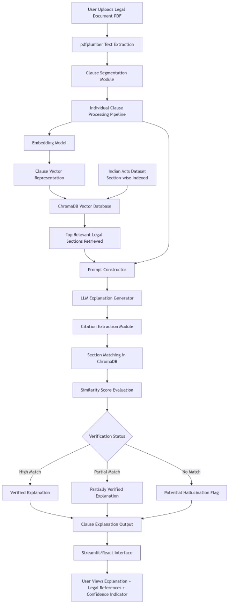
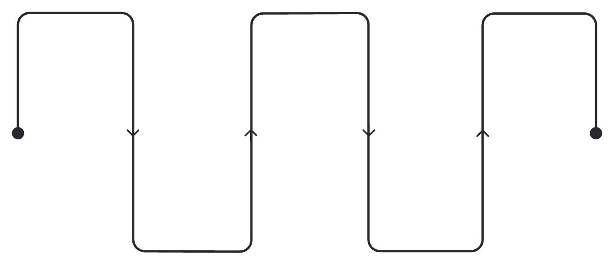
System Architecture
Upload PDF
Split Clauses
Query ChromaDB
User uploads the document
Segment into individual clauses
Retrieve relevant Indian Acts
Extract Text
Embed Clause
Parse PDF with pdfplumber
Generate Gemini embeddings
The pipeline ensures the LLM never answers from memory. Every explanation is grounded in retrieved Act sections and verified before reaching the user.

Slide 6

Modules 1–2: Build the Knowledge Base & Ingest Documents
Module 1 — Acts Database
Module 2 — Document Processing
Indian Acts are downloaded from IndiaCode and chunked at the section level. Each chunk is stored in ChromaDB with metadata: Act name, section number, and domain (family, property, labour, corporate).
User uploads a PDF. pdfplumber extracts raw text, then splits it into numbered clauses. Each clause becomes an independent unit for retrieval and explanation.
Clause 1: Rent amount and due date
Clause 2: Termination notice period
Clause 3: Arbitration terms
This is the only source of truth the system trusts.

Slide 7
Modules 3–4: Retrieve Law & Generate Explanation
Module 3 — Retrieval (RAG Core)
Module 4 — Grounded Generation
Each clause is embedded using Gemini Embedding API and queried against ChromaDB. Top 3 relevant Act sections are returned before any text is generated.
Clause + retrieved sections are sent to Gemini 1.5 Flash with a strict system prompt:
Explain at Class 8 English level
Only use the provided law sections
Cite exact Act name and section number
If law doesn't cover the clause, say so explicitly

Slide 8

Module 5: Hallucination Verification Layer
After Gemini generates an explanation, the system automatically verifies every cited section against the ChromaDB knowledge base.
Extract Citations
Lookup in ChromaDB
Compare Similarity
Assign Verdict
This post-generation check is the novel contribution of this system — no standard RAG pipeline includes automatic citation validation against a legal database.

Slide 9
Four Layers of Hallucination Reduction
Layer 1 — Retrieval Grounding
Layer 2 — Strict Prompt
LLM never answers from memory. It only sees retrieved Act sections.
Explicitly forbids Gemini from using outside knowledge or fabricating citations.
Layer 3 — Citation Verification
Layer 4 — Confidence Score
Every cited section is auto-checked against ChromaDB. Hallucinated sections are flagged.
Each clause gets a score: ✅ High (all verified), ⚠️ Medium (partial), 🚨 Low (hallucinated).

Slide 10

Tech Stack & Implementation Snapshot
Technology Choices
Sample Output — Clause 2
Component
Tool
Plain English: Your landlord can ask you to leave with 15 days notice. Standard agreements require 30 days under Indian law.
PDF Extraction
pdfplumber
Vector DB
ChromaDB
Legal Basis: Transfer of Property Act 1882, Section 106
Embeddings
Gemini Embedding API
Verification: ✅ Verified — Section 106 found, content matches
LLM
Gemini 1.5 Flash
Verification
Custom Python
Risk: ⚠️ Clause favors the landlord
UI
Streamlit

